Slide 1

Software Testing
Unit 2
Structural Testing
Prof Raghu B. A. Rao
Department of Computer Science and Engineering
‹#›
‹#›
‹#›

Slide 2

Structural Testing
List of Contents
Structural Testing
Unit/Code Functional Testing
Code Coverage Testing
Type of Code Coverage
Programming Constructs
Code/Path/Condition/Function Coverage
Code Complexity Testing
Department of Computer Science and Engineering

Slide 3
Structural Testing
Done by running the executable on the machine
Entails running the product against some predefined test cases and comparing the results against the expected results
Designing test cases and test data ( even test programs – stubs )to exercise certain portions of code
Types of structural testing
Unit / code functional testing
Code coverage testing
Code complexity testing

Slide 4
Unit/Code Functional Testing
Initial quick checks by developer
Removes “obvious” errors
Done before more expensive checks
Building “debug versions”
Running through an IDE
“Debugging” or “testing”? (Who cares?!)
Done at programmer level
Most of the times – “indirect & controlled” execution because other parts of programs not ready
Stubs, test harnesses….
Unit testing tools – Junit…

Slide 5
Code Coverage Testing
Focus is to cover all / required parts of code
Map parts of code to required functionality
Find out percentage of code covered by “instrumentation”
Instrumented code provides fine control on execution and measuring it.
Can help identify critical portions of code, executed often
Coverage = ( statements executed / Total statements ) * 100

Slide 6
Types of Code Coverage
Statement coverage
Path coverage
Condition coverage
Function coverage

Slide 7
Programming Construct
Sequential instructions
Two-way decision statements (if – then – else)
Multi-way decision statements (switch statements)
Loops, like while/do, for, repeat/until, etc

Slide 8
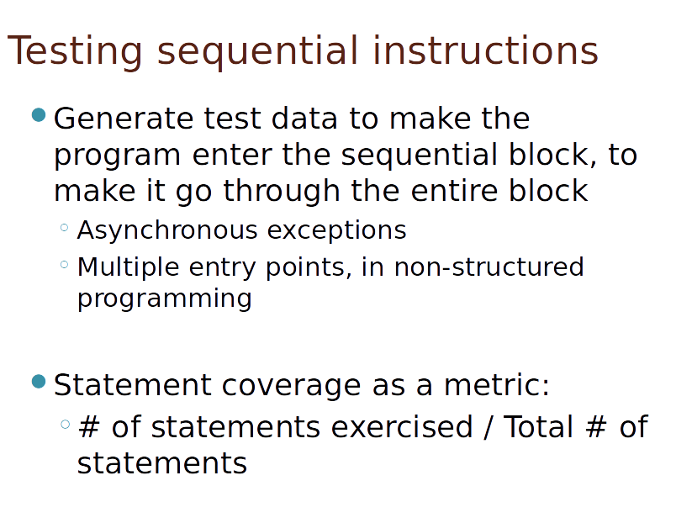
Testing Sequential Instructions

Slide 9
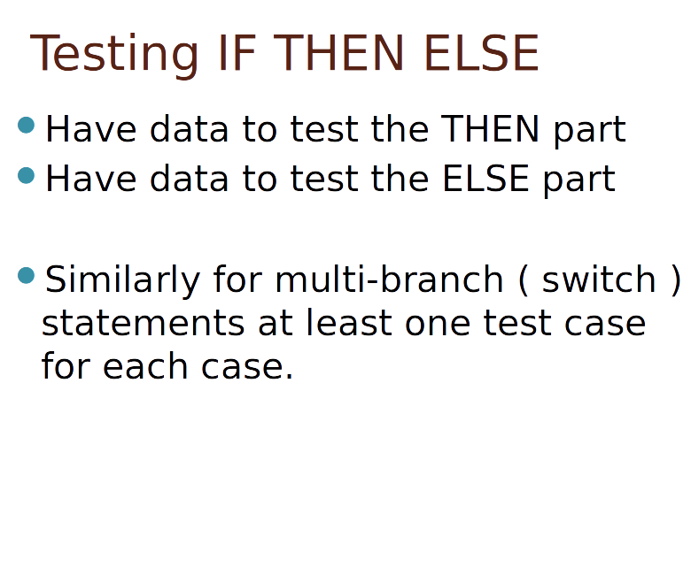
Testing IF THEN ELSE

Slide 10
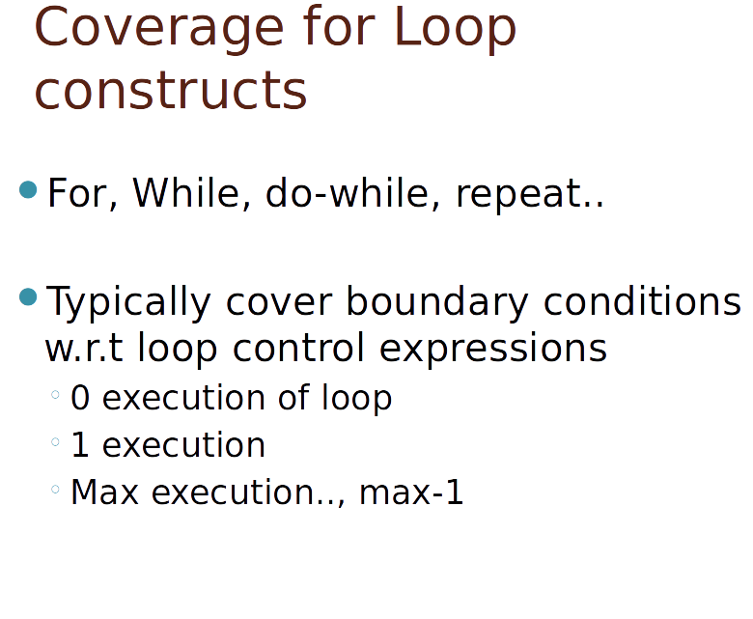
Coverage for Loop Constructs

Slide 11
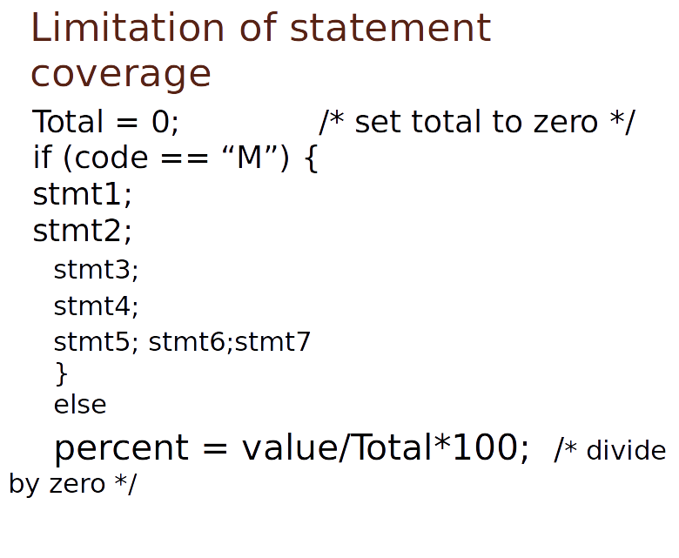
Limitation of Statement Coverage

Slide 12
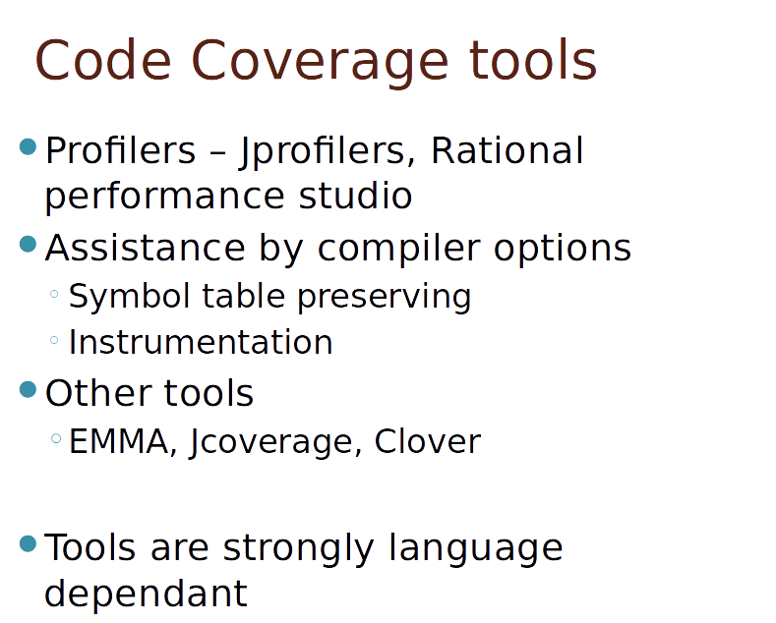
Code Coverage Tools

Slide 13
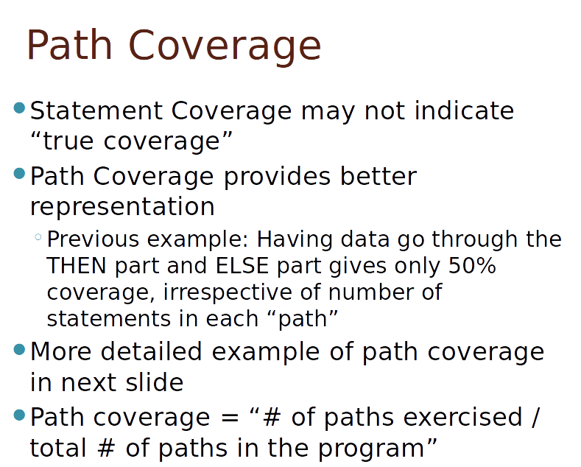
Path Coverage

Slide 14
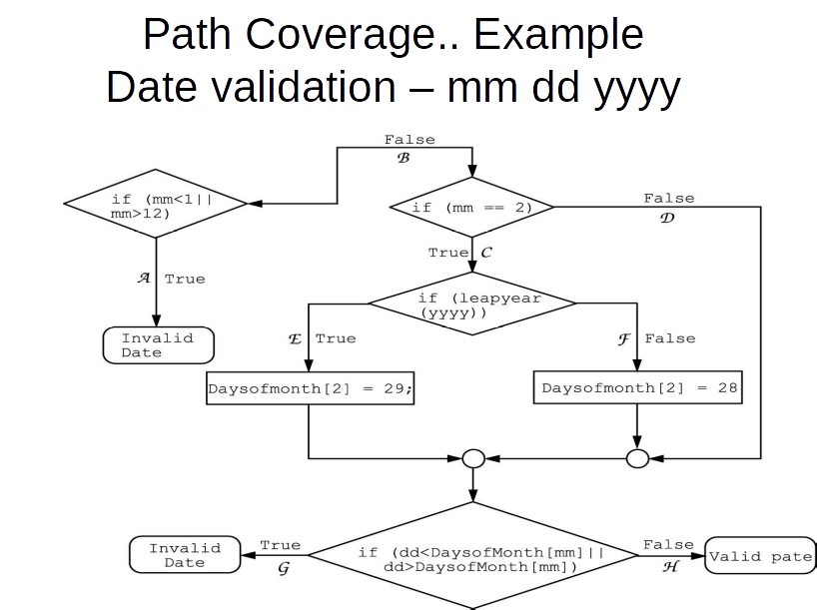

Slide 15
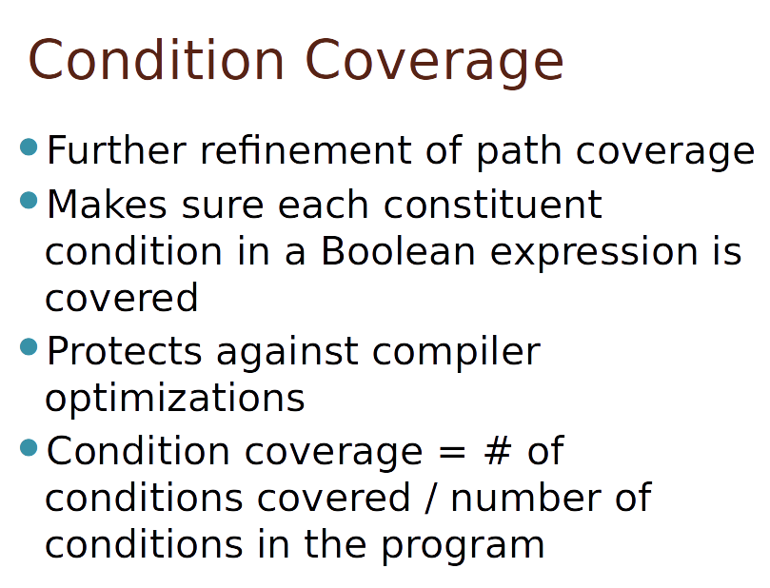
Condition Coverage

Slide 16
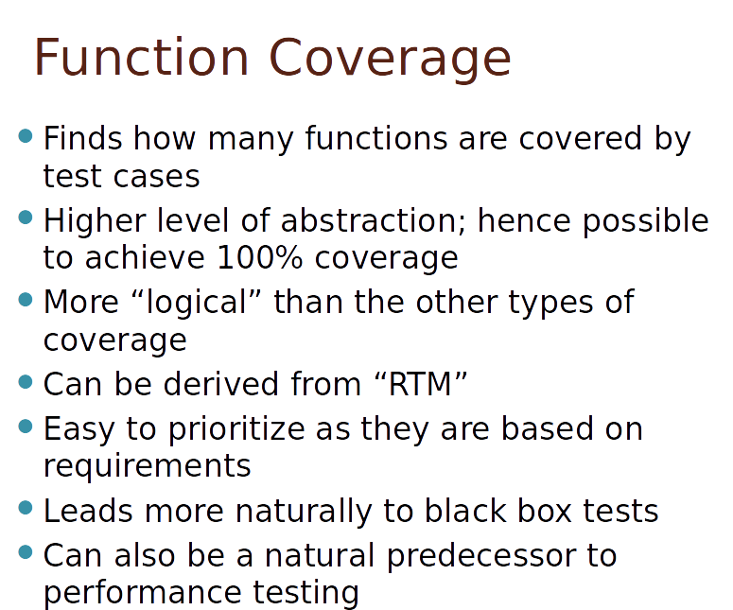
Function Coverage

Slide 17
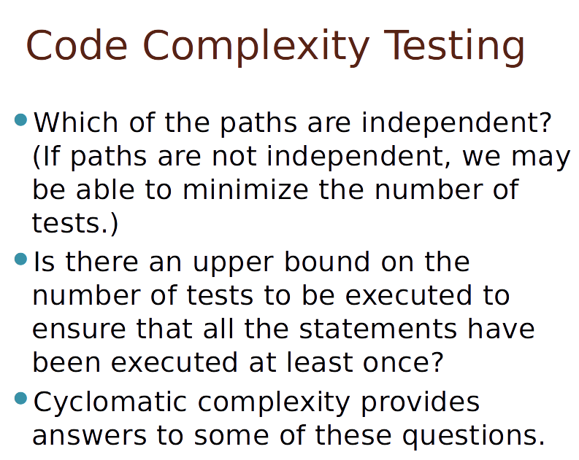
Code Complexity Testing

Slide 18
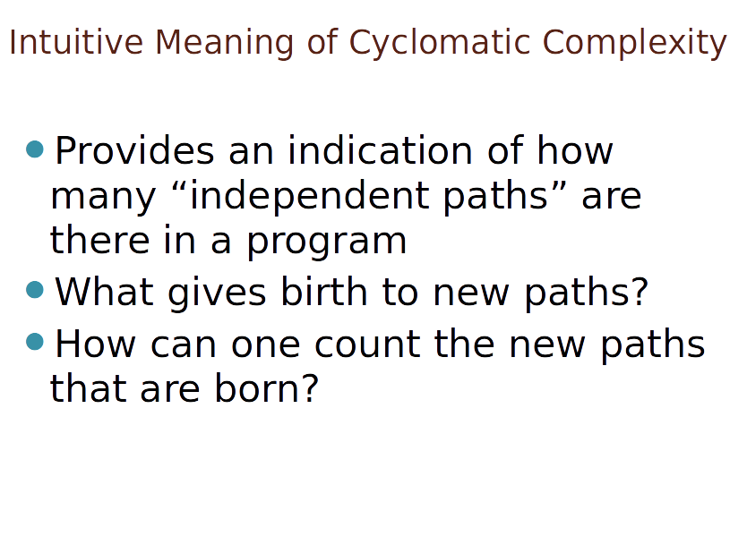
Intuitive Meaning of Cyclomatic Complexity

Slide 19
Uses of Cyclomatic Complexity
Helps developers and testers to determine independent path executions
Developers can assure that all the paths have been tested at least once
Helps us to focus more on the uncovered paths
Improve code coverage in Software Engineering
Evaluate the risk associated with the application or program
Using these metrics early in the cycle reduces more risk to the program
https://www.guru99.com/cyclomatic-complexity.html
Notes:
Cyclomatic complexity is a software metric used to indicate the complexity of a program.
It is a quantitative measure of the number of linearly independent paths through a
program's source code. It was developed by Thomas J. McCabe, Sr. in 1976.
Independent path is defined as a path that has at least one edge which has not been traversed before in any other paths.

Slide 20
THANK YOU
Prof Raghu B. A. Rao
Department of Computer Science and Engineering

